Slide 1
Bootcamp Session (Foundational Training Week-1)
Shivam Jindal
IDA

Slide 2
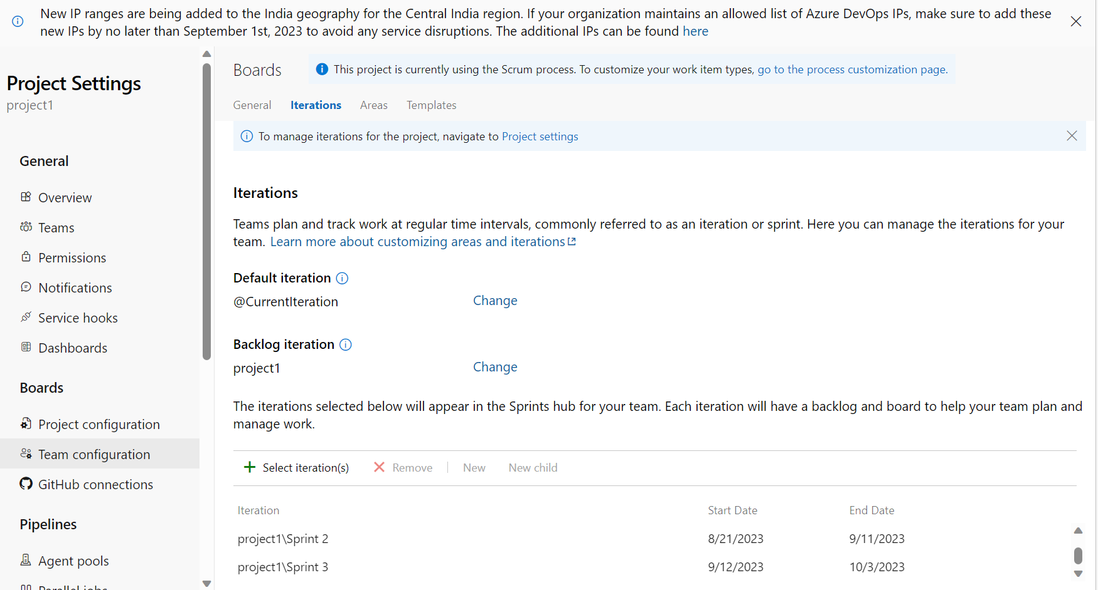
business Analysis and agile
- Brief introduction on Business Analysis
- Requirement Analysis
- Project Management
- Waterfall Model
- Agile Method
- Sprint
- Scrum and it’s purpose

Slide 3
Agile Continued
Agile is a project management and development approach focused on flexibility and collaboration.
Emphasis iterative progress, adaptability, and customer involvement.
Regular meetings like Daily Standups, Sprint Planning, Sprint Review, and Retrospectives enhance communication and alignment.
Continuous feedback loops help teams adjust and refine their work based on real world results.
Agile is widely used in software development but has also been adopted in other industries for managing projects and tasks.

Slide 4
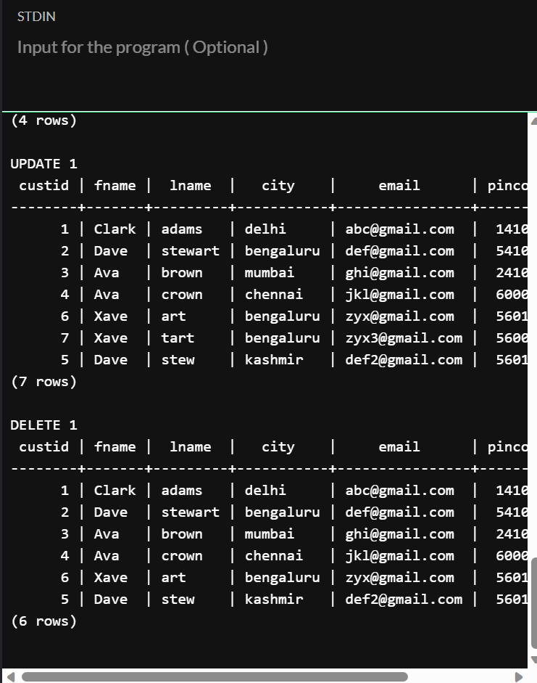
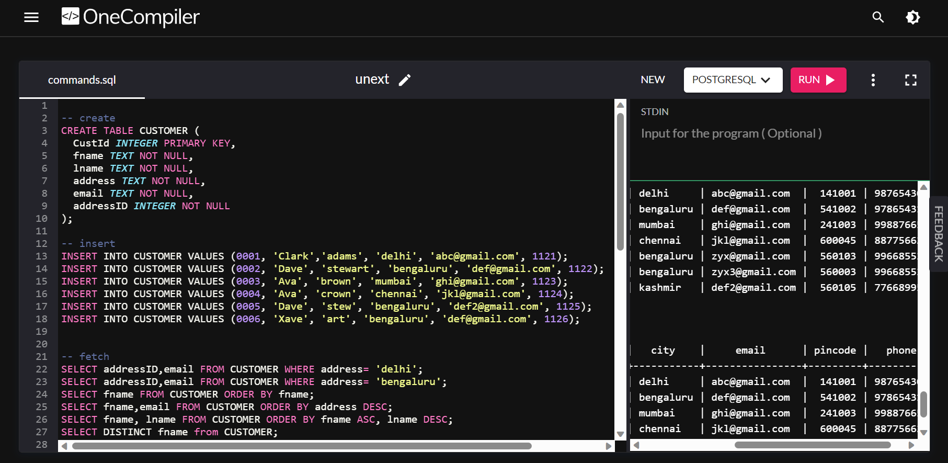
Database and Management SYtems
Brushed up basic concepts in PostgreSQL (Hands on Experience)
Creating Table, Inserting rows
Updation of entities, used operators like between, in , and , or and joins.

Slide 5
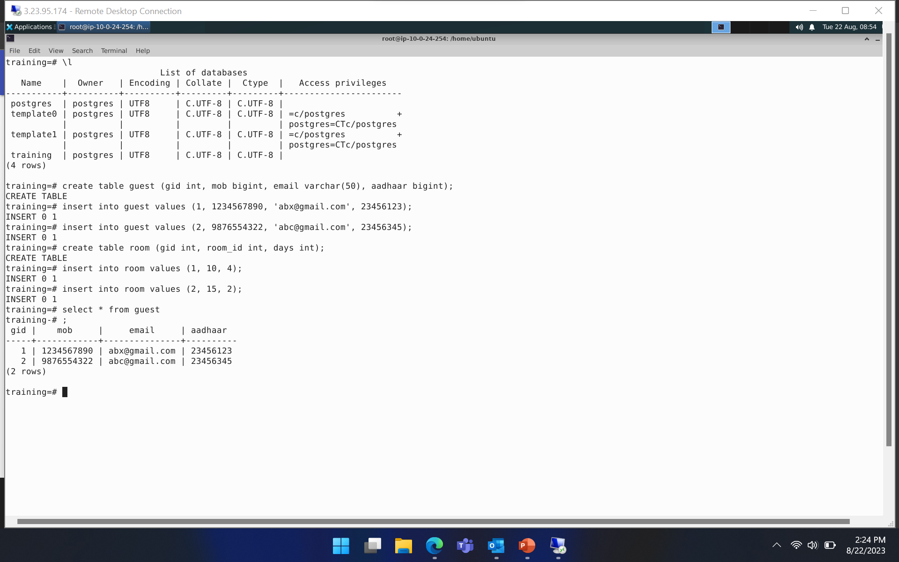
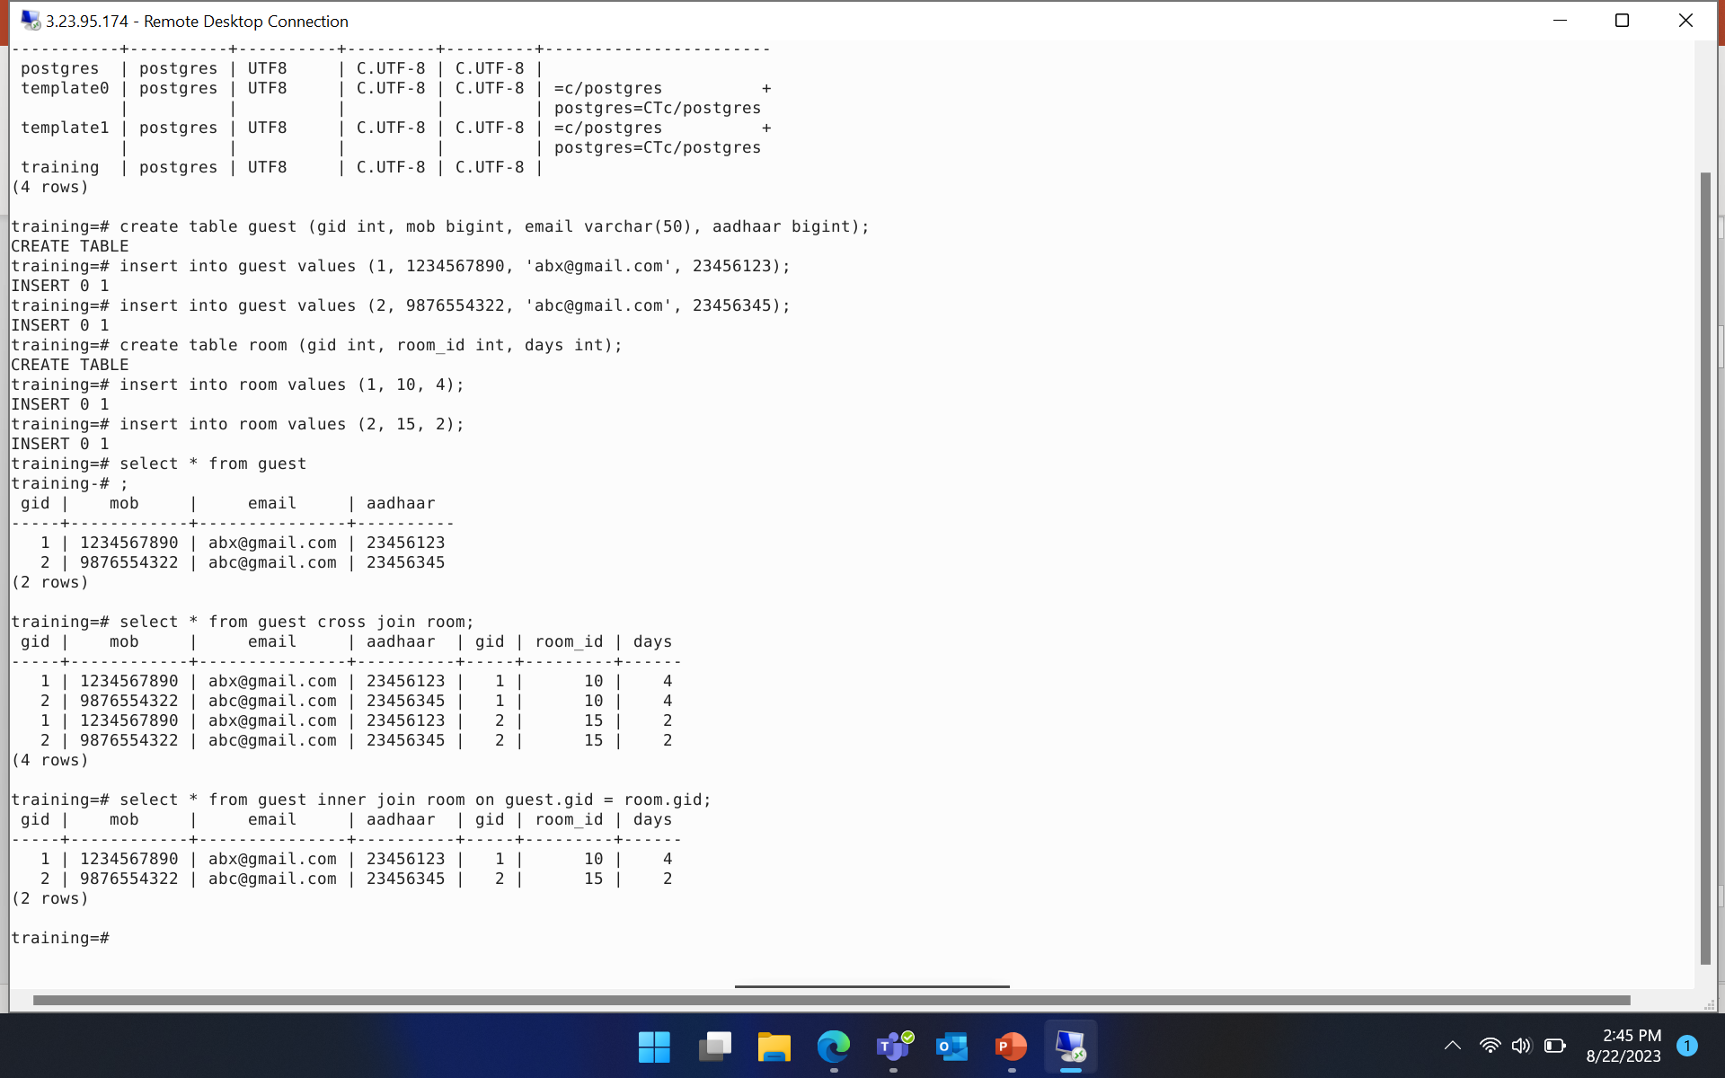
Postgresql

Slide 6
Software Testing
Understood how important Testing is for any product and the difference between bugs, defects and errors.
Learnt Software Development life cycle and Software testing life cycle with their stages that run in a loop.
Obtained insights on Unit testing and integration testing and the need to perform both.
Acquired knowledge on following classes: @BeforeAll, @BeforeEach, @AfterEach, @Order
Observed Softwares (For writing test cases) : Junit, Fitnesse .

Slide 7
STLC
Test plan – Purpose, Goals, Types, Cycles, Strategy, Schedules, Environment, Criteria. Metrics, Defect types, Risks, etc; will be planned in this stage
Test Requirements – All the requirements and sub requirements of the product are documented
Test case design – Necessary positive and negative test cases for each requirement is generated
Allocation – Testers and resources are allocated to each requirement based on priority and complexity. Test environment is prepared
Text execution – Actual testing happens
Test evaluation – The validation of testing done
Log defects – Defects need to be recorded
Test Reports – Final report of testing with all the analysis will have to be documented for further correction or deployment

Slide 8
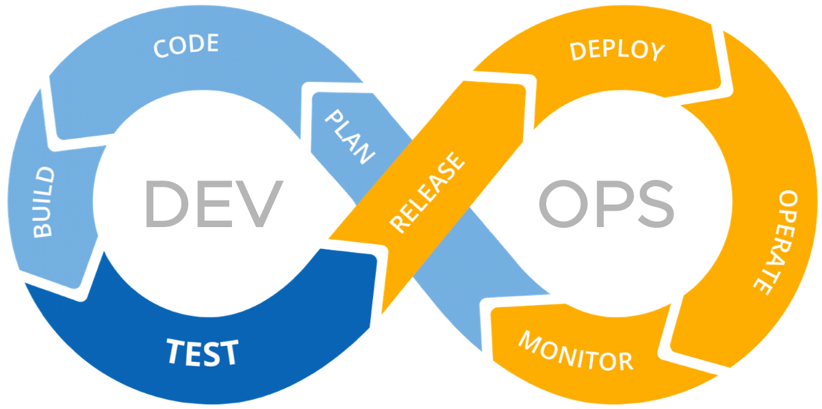
Devops (Development + operations)
This domain has the Development team that caters to the planning, designing, coding and testing of a product and the IT operations team verifies the requirements, deploys the product and monitors it.
These teams go hand in hand and run in a loop.
Gained an understanding on the seven stages of this domain.
continuous development
continuous integration
continuous testing
continuous deployment
continuous monitoring
continuous feedback
continuous operations

Slide 9
Cloud computing
Cloud Computing is a pretty useful concept to connect, store data, build, deploy and do much more virtually.
Acquired information on Iaas (Information as a service), Paas (Platform as a service) and Saas (Software as a service).
Built a Virtual machine using Microsoft Azure cloud services and understood the various configurations that could be used.
Applied customized disk storage and network settings based on the given requirements.

Slide 10
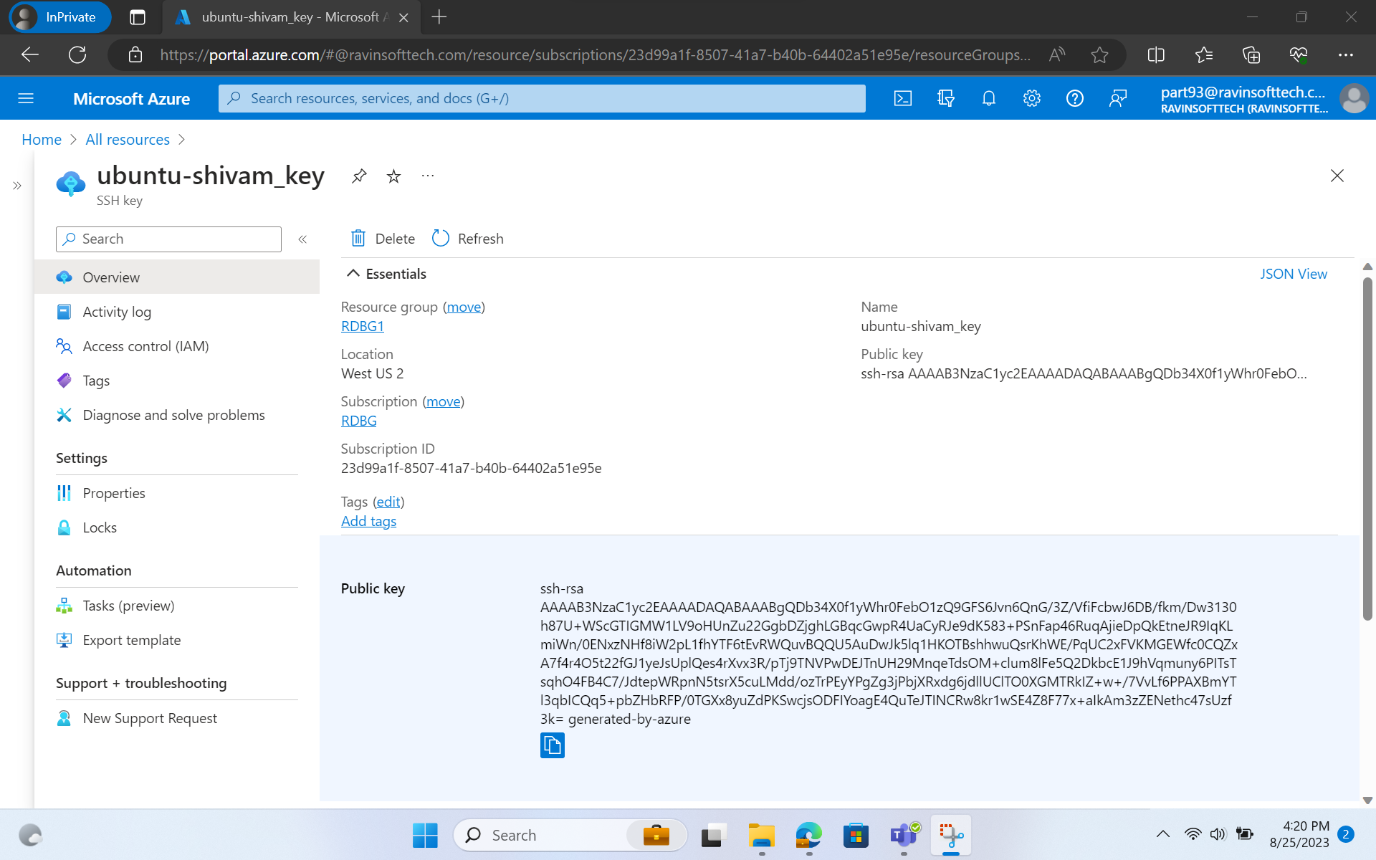
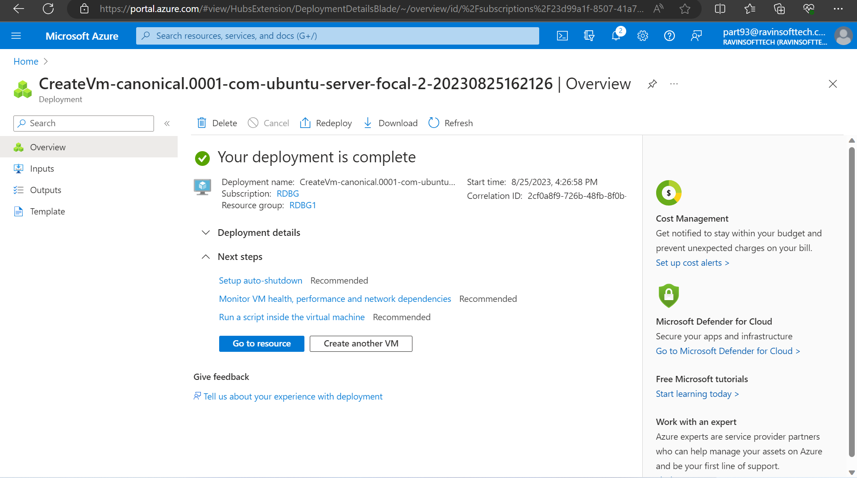
Microsoft Azure (Practical implementation)
Learnt basics of deployment using Microsoft Azure.
Gained insights on Resource groups and storage accounts.

Slide 11
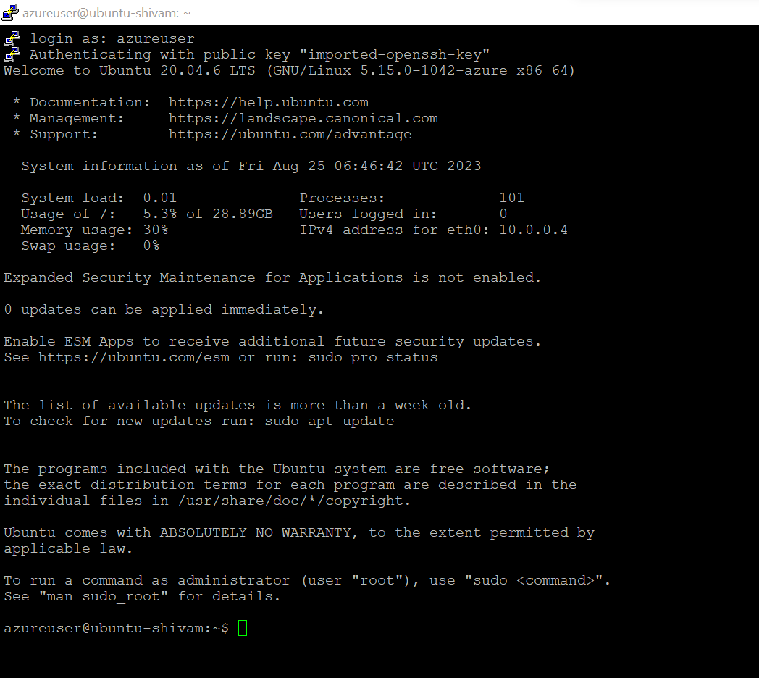

Putty and puttygen

